Slide 1
Thom Bargen Coffee Roasters
Social Media Analysis Rezone Abir

Slide 2
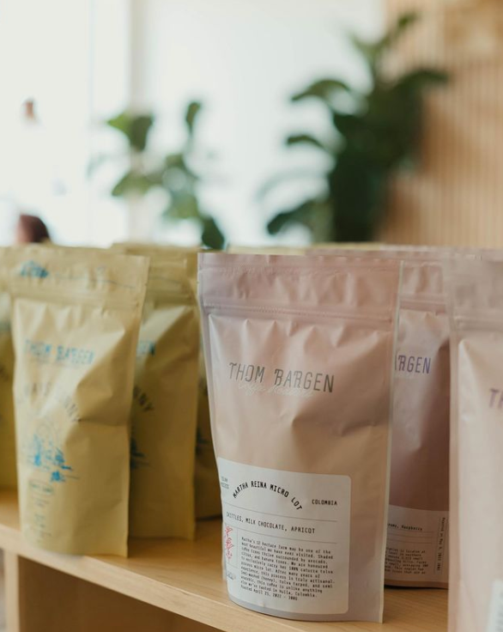
What is Thom Bargen’s?
A Small Coffee Shop
That Sells More Than Coffee…
Based in Winnipeg with two locations on Kennedy and Sherbrook Streets
Thom Bargen merch is available, as well as coffee delivery and subscriptions

Slide 3
Current Social Media Efforts
Twitter and Instagram

Slide 4
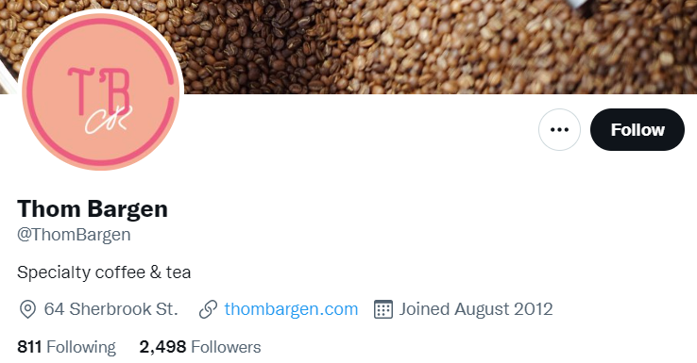
Twitter
Just Under 2500 Followers
Very Active - Mostly Instagram Reposts
Very Poor Results
Verdict: Low Effort, Low Results

Slide 5
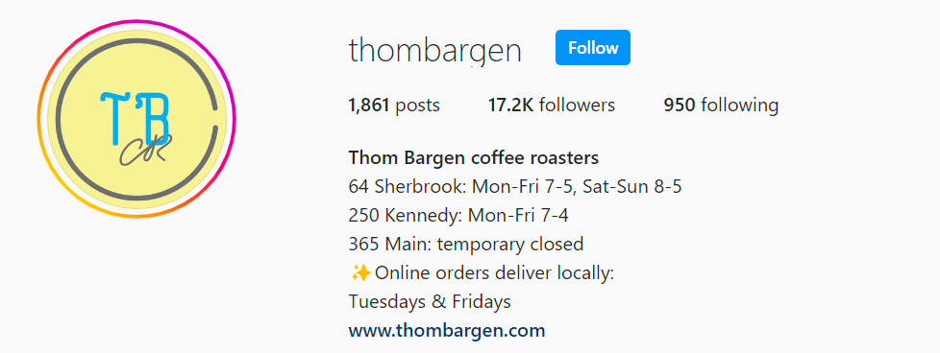
Instagram
Over 17K Followers and 1800 Posts
Greater Success than on Twitter
Averaging over 135 likes per post
Low Number of Comments Are a Weak Point
Verdict: High Effort, Medium Results

Slide 6
Ways to Increase Engagement

Slide 7
Regular posts of stories on Instagram with polls and featurettes of their signature coffees
Short Videos or reels of patron engagement and memorable moments
Collaboration with culinary influencers or coffee enthusiasts
Use the data to see when consumers are on instagram most to time posts/stories accordingly
Ask customers to film a quick testimonial reel
Keep up with target market trends/interests on TikTok and Instagram to know what other content to post
Find complementary goods to collaborate with
Local food awards
Utilize polls from earlier to see who people are interested in you collaborating with

Slide 8
Schedule posts across more platforms
Hire a brand ambassador
Hootsuite
LinkedIn, Indeed
Well-known influencer
Notes:
Utilizing Hootsuites publishing features, you will be able to schedule posts to multiple platforms at the same time.

Slide 9
Utilizing Emerging Social Media Platforms
TikTok and Twitter

Slide 10
TikTok
Twitter
TikTok is taking the world by the storm! It’s the most effective platform in 2022 to take your business to the next level.
Tips:
TikTok “be your own barista” challenge
Use of influencers to promote drinks
Post consistently!
Ads
Twitter is a fantastic platform to increase brand awareness and customer engagement.
Benefits:
One on one communication
Give out free coffee/coupons on holidays
Run contests to increase engagement
Advertise promotions and menu items

Slide 11
Trends
Influencers
Custom coffee drinks
Do it yourself
Share your favorite order
Examples
Dalgona coffee
Hard coffee
Sustainable coffee
Influencer drinks
Influencers usually focus on a specific market to advertise. If an individual is following them, it’s usually because they are interested in that type of content.
Examples:
Local influencers (ex: WpgEats)
Schools/universities
Communities
Related stores (ex: breakfast shops)

Slide 12
Experiences
Positive: The environment in Thom Bargen is clean, fresh and welcoming. Their social media is useful to keep up to date with their new drinks and coffee roasts that they serve.
Negative: Like said earlier in this presentation, their Twitter accounts primarily reposts Instagram posts. More effort could be put into putting original posts on Twitter to be more interactive on that platform.

Slide 13
Key takeaways
Focus on growing Twitter; keep the consistency on Instagram
Allow customers to engage and respond back
Use influencers
Trends can make you popular!

